Slide 1


2. 非线性代数方程求解 Root finding for nonlinear sets of algebraic equations
Yahui Wang, Jie Li, Yu Ma
Sino-French Institute of Nuclear Engineering & Technology, SYSU
1

Slide 2
总览 Overview
求根问题 Root finding problems
迭代方法 Iteration method
牛顿迭代法 Newton-Raphson method

Slide 3
1.求根问题 Root finding problems
Defined as
E.g.
Given a continuous function f(x) , find the value x* such that f (x*) = 0

Slide 4
Solution methods
The main three ways in solving non-linear equations
Analytical solutions
Only for some special and simple equations
Graphical solutions
Only for estimation for the region of solution. Not accurately!
Numerical solutions
Provide solutions for any equations with certain accuracy.

Slide 5
2. 不动点迭代Fixed point iteration method
For an equation f(x)=0, we change to the form
Giving an initial value x0, compute
When n is large enough, x_{n} will approximate the exact solution x* ( x*=g(x*), or f (x*)=0 ), i.e.

Slide 6
An example. Solve the equation
Change to iterative form
Giving the initial value x₀=0, we have
k | x_{k}
0 | 0
1 | 1.59823802
2 | 0.88101238
30 | 1.39383272
50 | 1.39709713
100 | 1.39723030
1000 | 1.39723034

Slide 7
What kind of iteration form to use ?
The following form will diverge
How to choose the initial value ?
Choose x₀=10 will diverge
How fast is the convergence ?
Different iteration forms or initial values will greatly affect the converge speed

Slide 8
不动点定义
Fixed point. A fixed point of a function g(x) is a real number P such that P=g(P)
Fixed point iteration

Slide 9
不动点存在性与唯一性
The existence of uniqueness for a fixed point
Theorem. Assume that g∈C[a,b],
(1). If the range of the mapping y=g(x) satisfies y∈[a,b] for all x∈[a,b], then g has a fixed point
(2). Suppose that g’(x) is defined over (a,b) and that a positive constant K<1 exists with |g’(x) | ≤K<1 for all x∈[a,b], then g has a unique fixed point P in [a,b]
Proof:
(1). Construct f(x)=x-g(x)
(2). Contradiction way. Use mean value theorem
Existence
Uniqueness
g’(x)= (g(P1)-g(P2))/(P1-P2) = 1

Slide 10
不动点定理
Convergence of the fixed point iteration
Fixed point Theorem.
Assume that
(i) g, g’ ∈C[a,b]
(ii) K is a positive constant
(iii) p₀ ∈(a,b)
(iv) g(x) ∈[a,b] for all x∈[a,b]
If |g’(x)|≤K<1 for all x∈[a,b], then the iteration p_{n}=g(p_{n-1}) will converge to the unique fixed point P∈[a,b]. P is called an attractive fixed point.
If |g’(x)|>1 for all x∈[a,b], then the iteration p_{n}=g(p_{n-1}) will not converge P. P is called a repelling fixed point and the iteration exhibits local divergence.
Proof: ?
Implication ?

Slide 11
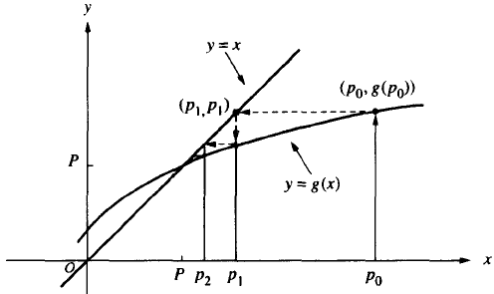
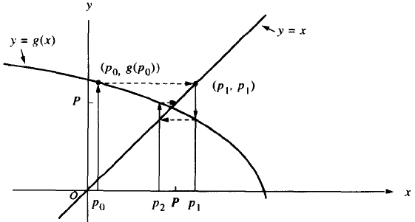
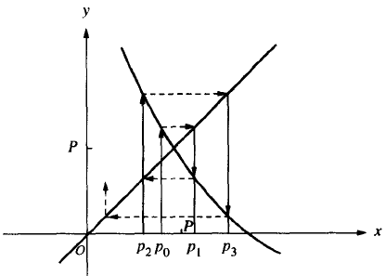
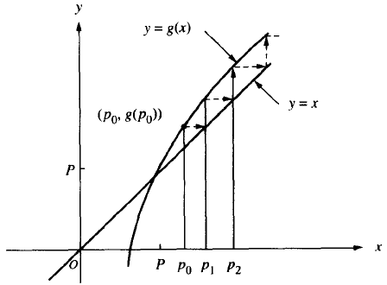
Graphical interpretation
0<g’(P)<1
-1<g’(P)<0
g’(P)>1
g’(P)<-1

Slide 12
※收敛速度Convergence speed
Definition
Assume that {P_{n}}_{n=0,…, ∞} convergence to p and set E_{n}=p - p_{n} for n≥0. If two positive constants A≠0 and R>0 exist, and
then the sequence is said to converge to p with order of convergence R.
R=1: linear convergence
R=2: quadratic convergence

Slide 13
Theorem
Assume that {P_{n}}_{n=0,…, ∞} for the iteration p_{n+1}=ϕ(p_{n}) convergence to p. If
the iteration is convergent with R-th order.
Proof. Using the Taylor expansion, we have
Then the order is
This theorem tells us different forms of iteration would result in different convergence speeds

Slide 14
Example. Four different types of iteration for computing the root of x²-3=0
(1). x = x² + x - 3
(2). x =3 / x
(3). x =x - ¼(x²-3)
(4). x = ½ (x + 3/x )
k | x_{k} | (1) | (2) | (3) | (4)
0 1 2 3 ┆ | x₀ x₁ x₂ x₃ ┆ | 2 3 9 87 ┆ | 2 1.5 2 1.5 ┆ | 2 1.75 1.73475 1.732361 ┆ | 2 1.75 1.732143 1.732051 ┆

Slide 15
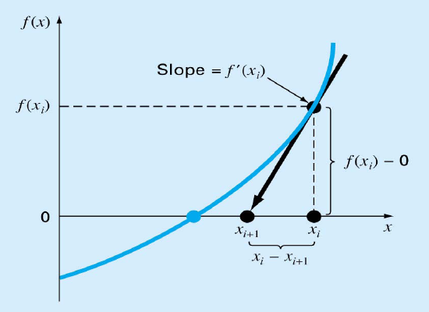
3. 牛顿迭代Newton-Raphson (Newton’s) method
The idea of Newton’s method depicted in graphics
Using the initial guess at the root x_{i} ,
and the derivative f’(x_{i}) at x_{i} ,
we estimate the next value x_{i} by equation of the linear line,
f(x)=0
Convergence speed ?
Convergence stability?
Improved methods ?

Slide 16
Another explanation using Taylor expansion.
We intend to solve the equation using an implicit scheme, i.e.
Using Taylor expansion, the formula is expressed by
Omitting the high order approximation, this will give

Slide 17
Newton-Raphson Theorem
Assume that f∈C²[a,b] and here exists a number p∈[a,b], where f (p)=0. If f’(p) ≠0, then there exists a δ>0 such that the sequence {p_{k}} k=0,…∞ defined by the iteration
will converge to p for any initial value p₀ ∈[p- δ,p+ δ] .
Proof.

Slide 18
Convergence speed of Newton’s method
Given the iteration form
we have
The convergence speed is quadratic according to

Slide 19
If f(x) 在x*是n重根呢？
收敛速度有何改变？有没办法恢复2阶收敛速度? 如何证明修改后的迭代格式收敛速度达到二阶？
https://wenku.baidu.com/view/052d4ec110a6f524cdbf85a5.html
教材：2.4.6节
将在TD课分析解决方案

Slide 20
Example.
Find the solution for f (x)= x³-2x²+x-3, with initial value x₀=4. (x*=2.17455941029298, other 2 roots are virtual)
The derivative of f (x) is
Then the Newton iteration are
f ‘(x)= 3x²-4x+1

Slide 21
Implementation
Flow chart
Given the function f(x), f’(x) and initial values x₀
For k=0, 1, 2, ……
Compute the value f(x_{k}), f’(x_{k})
Evaluate the next value x_{k+1} = x_{k} - f(x_{k}) / f’(x_{k})
Compute the relative error err= |x_{k+1} - x_{k} | , If err<1.e-8 (or other small values), exit
Output the results

Slide 22
非线性方程组的牛顿迭代Newton’s iteration for nonlinear system
(Section 3.7.5 in textbook)
For solving the nonlinear system F(X)=0, .i.e.
we have an initial guess of the root X₀. Then the Newton iteration for this system would be
where F’(x) is the Jacobi matrix.

Slide 23
问题：如何准确推导出上面迭代格式？
（提示：使用多元Taylor展开!）

Slide 24
Example. Solve the following system of equations:
using Newton’s iteration
First we list the functions, Jacobi matrix and initial values

Slide 25
Then the iteration would be

Slide 26
3. 线性方程的迭代求解方法The iterative methods for solving linear systems

Slide 27
主要内容
雅可比迭代 Jacobi iteration
高斯-赛德尔迭代 Gauss-Seidel iteration
超松弛迭代 SOR method iteration

Slide 28
1. 直接解法的问题
对于线性方程组
当 A 为大型稀疏矩阵方程组时(A的阶数n很大，但零元素较多)。当n为10⁷时，即使非零元素只有10⁸ (通常工程问题会这样), 使用高斯消去法的计算量为O(n³), 其存贮量约为 8×10⁵G, 在浮点峰值为10¹²/s的计算机上，约需要30年。
而使用较好的迭代法求解时，存储量将为原来的1/10⁶(只存非零元素)，如果通过20左右迭代步收敛，几分钟内便可得到结果。

Slide 29
2. 迭代法基本框架
将要求解的线性方程线
左边矩阵分裂
我们得到迭代格式
对于上式，我们可以利用不动点迭代法

Slide 30
迭代格式
M, N 如何选择才能使计算量达到最小，以及收敛最快 ？

Slide 31
3. Jacobi迭代法
为使求逆过程简单，M 选取为 A 的对角元素，即
将 A分解成严格上三角阵U，对角阵D，下三角L
其Jacobi迭代过程为

Slide 32
写成矩阵形式为

Slide 33
以分量形式表达成

Slide 34
4. Gauss-Seidel 迭代法
基本想法：计算后面的迭代式子时，利用前面已经更新的值
或简写成
称为 Gauss-Seidel 迭代法

Slide 35
Gauss-Seidel迭代写成矩阵形式
迭代矩阵

Slide 36
Jacobi .VS. Gauss-Seidel 迭代
理论上说，Gauss-Seidel 迭代在同一迭代步中将已经更新的值(即更接近准确解的值)用在其它值的计算中，它的迭代速度能比Jacobi迭代法要快，达到同样精度时Gauss-Seidel迭代所需要的迭代步数更少。既节省内存，又给编制程序带来更多方便
例 分别用Jacobi和Gauss-Seidel迭代求解下面方程

Slide 37
Jacobi 迭代格式
取 x⁽⁰⁾=(0,0,0)^{T} 计算结果如下：
k | x₁^{(k)} | x₂^{(k)} | x₃^{(k)}
1 | 0.72 | 0.83 | 0.84
2 | 0.971 | 1.07 | 1.15
… | … | … | …
11 | 1.099993 | 1.199993 | 1.299991
12 | 1.099998 | 1.199998 | 1.299997

Slide 38
Gauss-Seidel 迭代格式
取 x⁽⁰⁾=(0,0,0)^{T} 计算结果如下：
k | x₁^{(k)} | x₂^{(k)} | x₃^{(k)}
1 | 0.72 | 0.902 | 1.1644
… | … | … | …
8 | 1.099998 | 1.199999 | 1.3

Slide 39
编程实现
流程图：Gauss-Seidel迭代
1. 判断矩阵对角元素是否有零，若有零，将增广矩阵进行初等行变换使对角元素不为零
2. 选取初始值，如每个元素分别为0至1的一个随机数
3. 迭代步数k从1开始
(1). 对解元素x_{i}, i=1至n分别计算
(2). 判断解是否收敛，若满足
则收敛，退出迭代
4. 返回，输出结果

Slide 40
代码
Linear.h :
#ifndef LINEAR_H
#define LINEAR_H
// solve equations Ax=b, A is n*n matrix, note: A is a dynamically allocated 2d arrays
// Jacobi iteration
int JacobiIter( double **A, double b[], double x[], int n );
// Gauss-Seidel iteration
int GaussSeidelIter( double **A, double b[], double x[], int n );
#endif

Slide 41
5.※逐次超松弛法(Successive Over-Relaxation, SOR)
在Gauss-Seidel迭代基础上，建立一个预测-校正步
其中式一为使用Gauss-Seidel格式进行的预测式子，式二为两个迭代步 k,k+1 之间的插值
当 ω =1 时，只取(k+1)步预测值
当 0<ω<1 时，插值为内插
当 ω >1 时，插值为外插。特别地ω =2时，属于中心外插
预测
校正

Slide 42
推导矩阵形式的SOR
选取分裂矩阵M为下面形式
另一分裂矩阵N为
则迭代格式为

Slide 43
编程实现
流程图
判断矩阵对角元素是否有零，若有零，将增广矩阵进行初等行变换使对角元素不为零
选取初始值，如每个元素分别为0至1的一个随机数
迭代步数k从1开始
(1). 对解元素x_{i}, i=1至n分别计算
(2). 判断解是否收敛，若满足
则收敛，退出迭代
返回，输出结果

Slide 44
其它更高效线性方程组迭代求解方法
共轭梯度法(Conjugate gradient method)
BiCGM
CG on the Normal Equations (CGN)
Generalized Minimal Residual (GMRES)
BiConjugate Gradient (BiCG)
Quasi-Minimal Residual (QMR),
Conjugate Gradient Squared method (CGS)
BiConjugate Gradient Stabilized (BiCGSTAB)

Slide 45
一些开源的线性方程求解包
Laspack (C) http://www.mgnet.org/mgnet/Codes/laspack/html/laspack.html
PETSc : http://www.mcs.anl.gov/petsc/
SparseKit2: https://people.sc.fsu.edu/~jburkardt/f77_src/sparsekit2/sparsekit2.html
SparseLib++ : http://math.nist.gov/sparselib++/

